Slide 1

Instagram

Slide 2

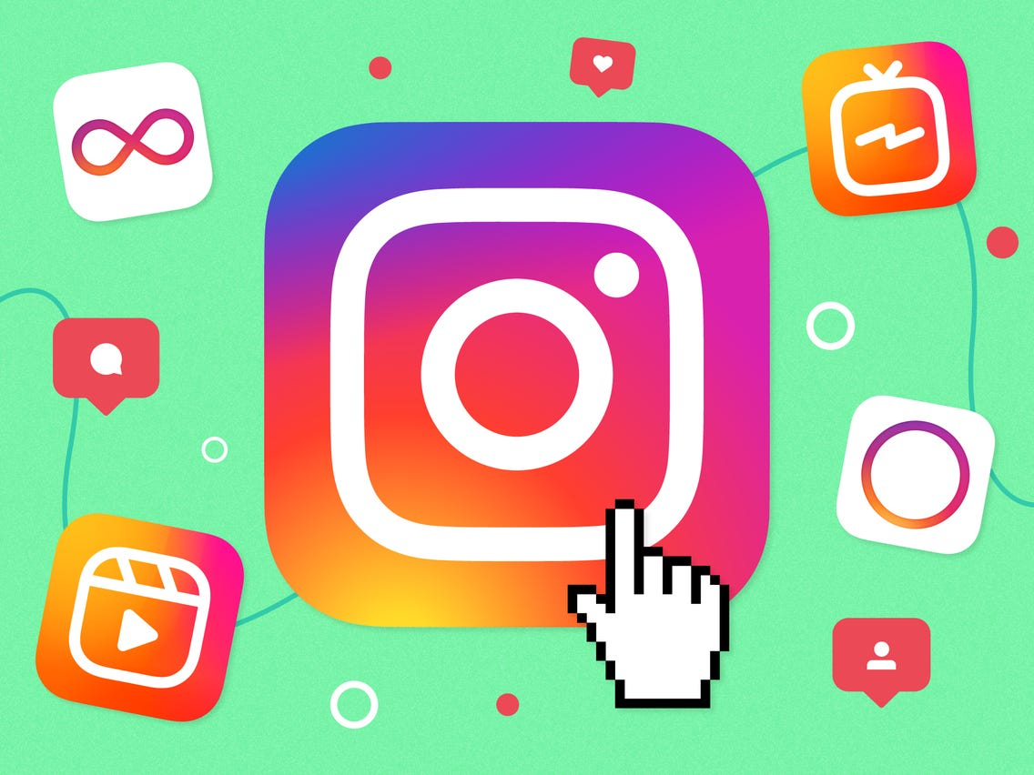
Agenda
What is Instagram?
Presentation and main objective.
Positive and Negative of Instagram.
How business can profit Instagram .
Do’s and don’ts of Instagram.
Conclusion.

Slide 3
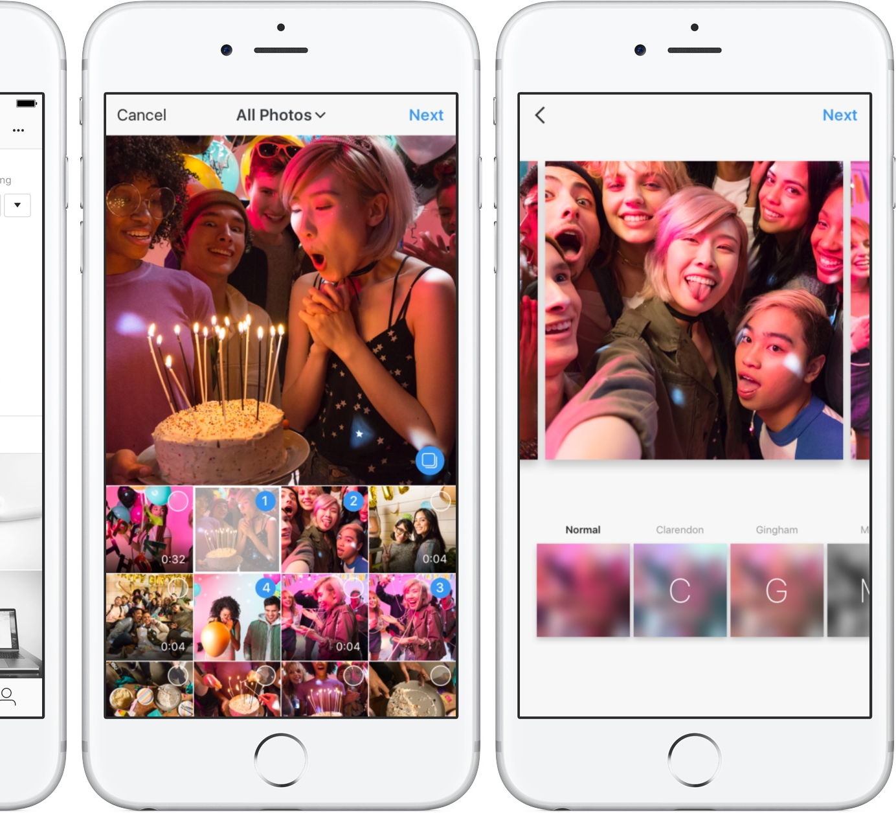
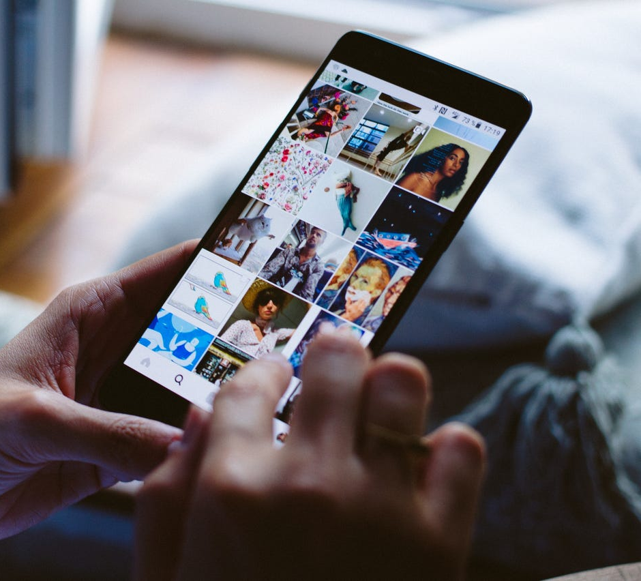
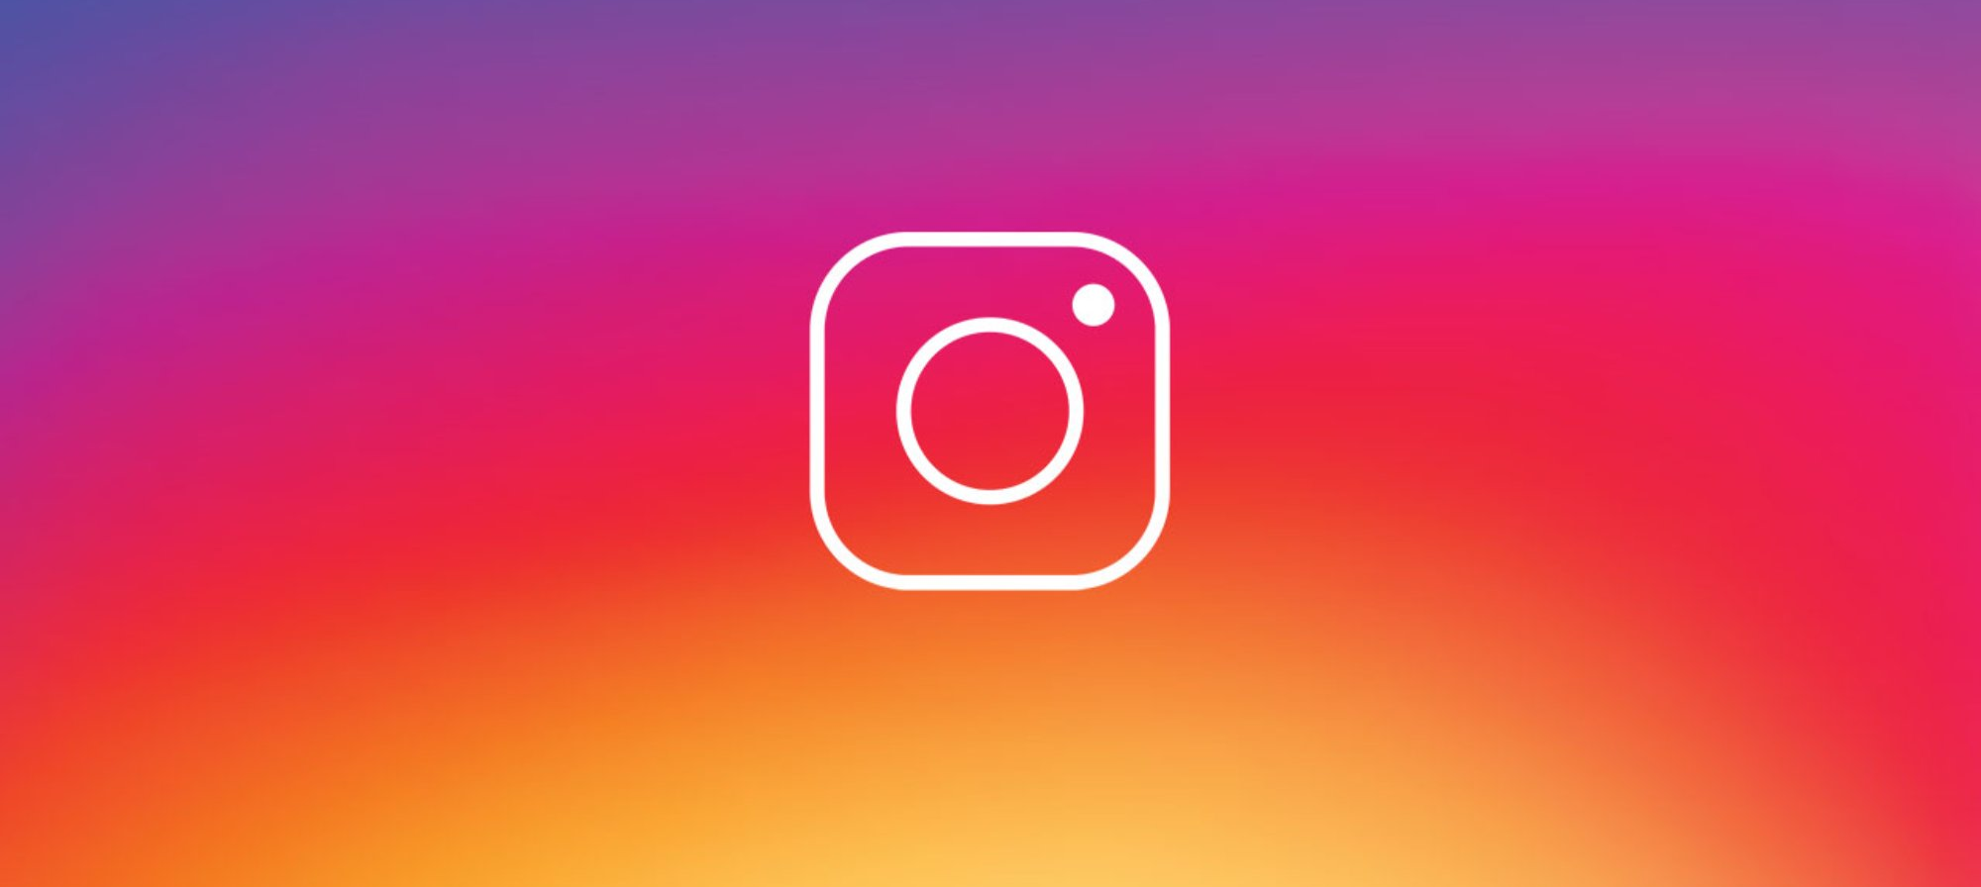
What is Instagram ?
Share photos and videos.
Capture the moment.
Easy to sign up.
Connect with friends.
Connect with the world.

Slide 4
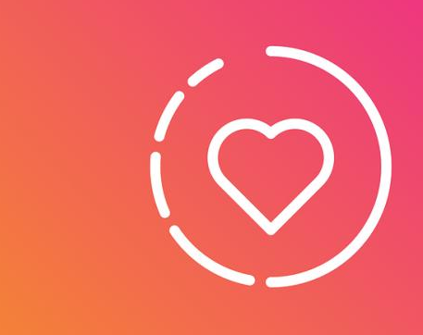
Presentation and main objectives
Introduction to the social media
Positive and negatives
Demonstrate how businesses can profit from the application
Do’s and don’ts of a business instagram

Slide 5
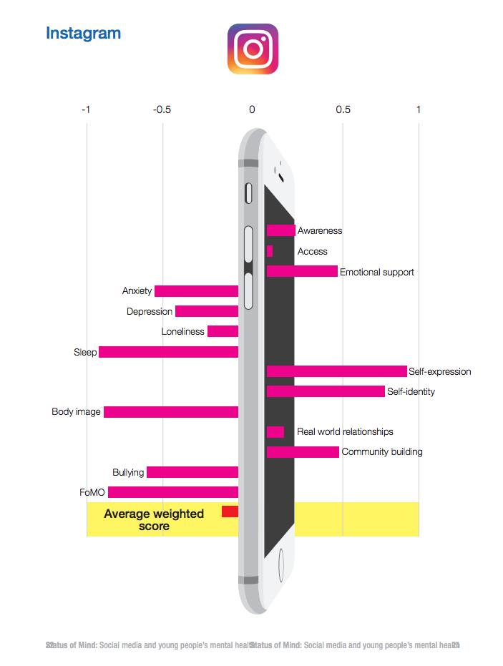

Positive and Negative of Instagram
POSITIVE
Great way to establish new relationships
Fast growing community
Great privacy
Constant new features-Stories
NEAGTIVE
Hard to share long written messages
Limited direct communication

Slide 6

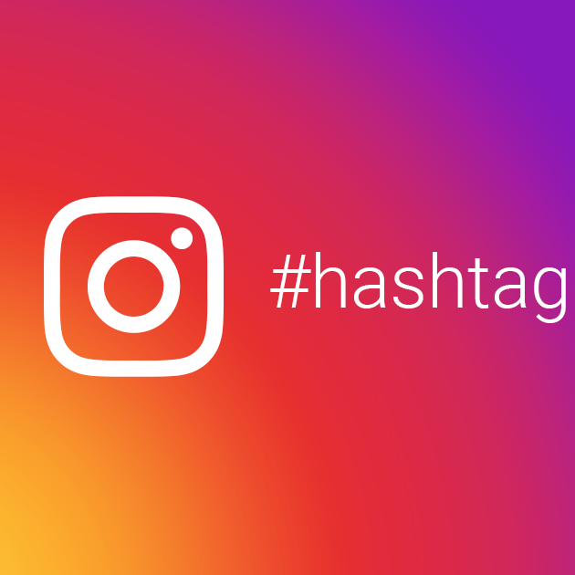
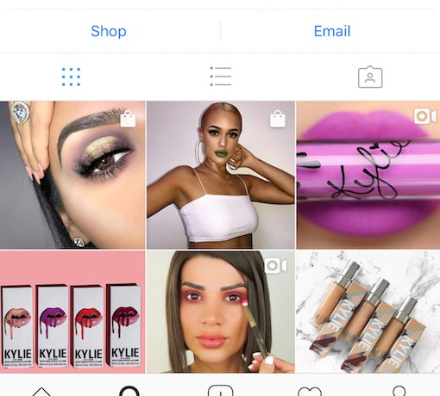
How businesses can profit from Instagram
Use influence or celebrities
Tags on posts
Buy advertisement from Instagram
Throw a give-away

Slide 7


Do’s and Don’ts of Instagram
Do’s
Know your target market
Quality over quantity
Use Instagram stories
Use analytics
Engage with people
Don’ts
PRIVATE ACCOUNT
Hashtags
Low quality photos
Pay for followers or likes
DM for a feature

Slide 8
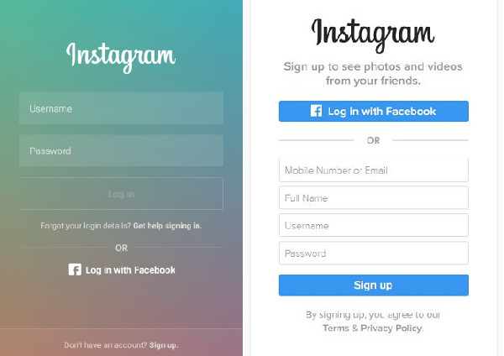
Conclusion
Easy sign up
Share your messages through photos
Great for promoting products and businesses
Follow do’s and don’ts

Slide 9
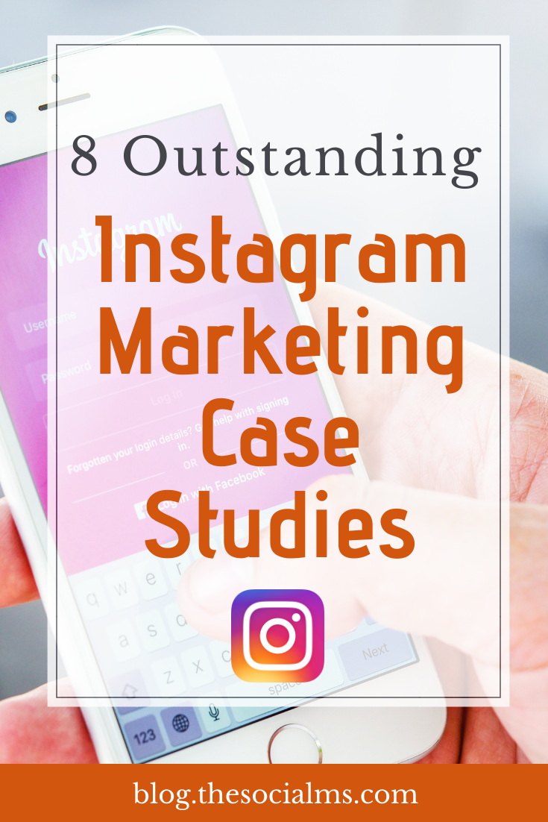
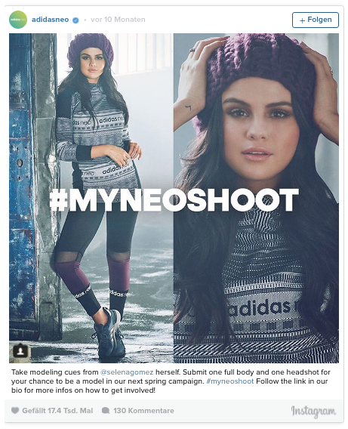
Case Study-
Creating Brand Awareness for Adidas Neo with an Instagram Campaign
Adidas invited Instagram influencers AND ordinary people to take part in a contest around Adidas Neo: Create Adidas Inspired Instagram posts. From these, Adidas chose the best content creators to model in a professional photoshoot and their branded content with engaged Instagram audiences.

Slide 10
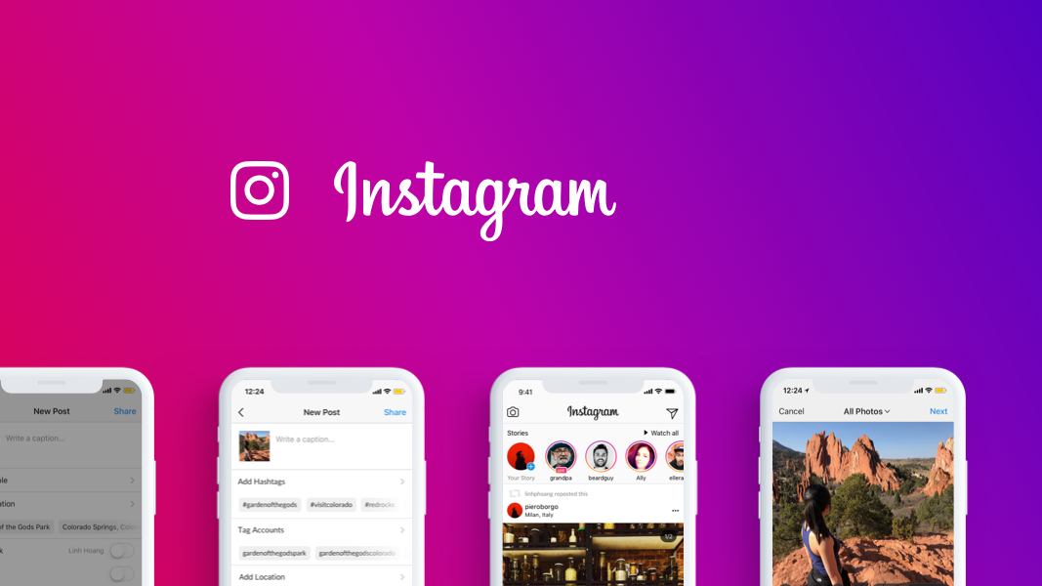
Thank You

